Slide 1

JavaScript
Introduction

Slide 2
01
02
03
04
05
06
07
Introduction to JavaScript
Variables
Operators
Conditionals
Loops
Built-In Types
Regular Expression

Slide 3
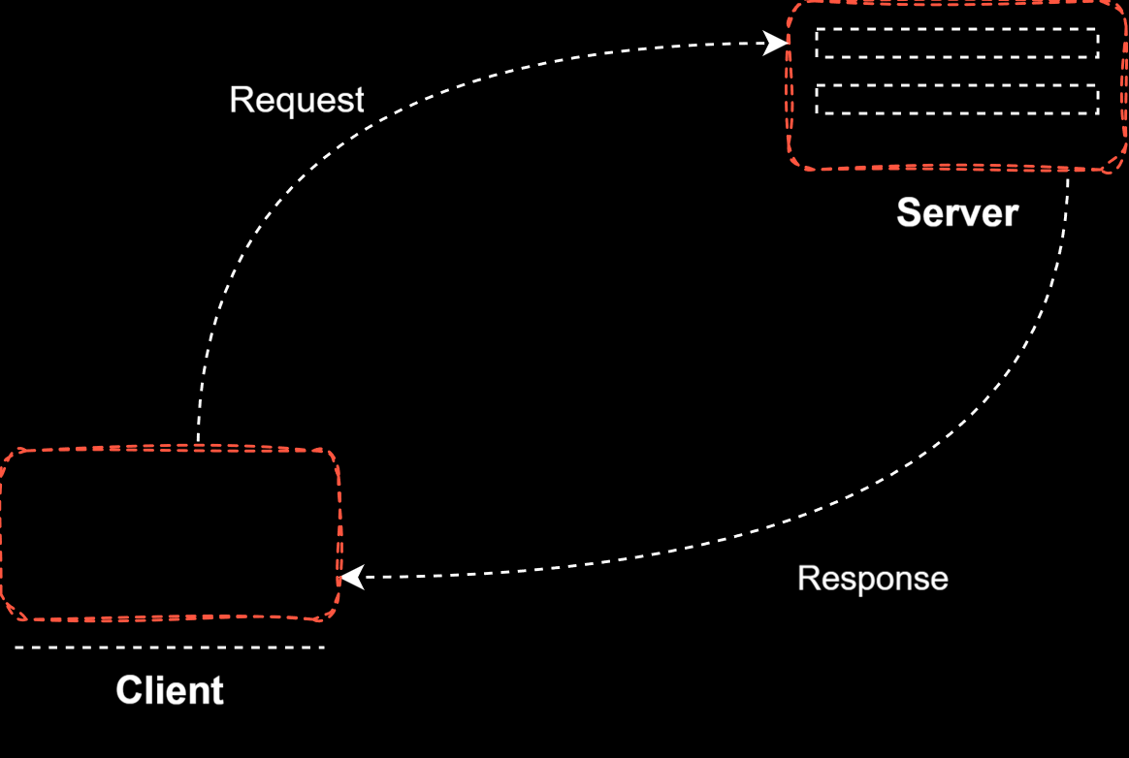

What is JavaScript ?
Created by Netscape
Originally called LiveWire then LiveScript
A client-side scripting language
Client-side refers to the fact that it is executed in the client (software) that the viewer is using. In the case of JavaScript, the client is the browser.
A server-side language is one that runs on the Web server. Examples: PHP, Python
Interpreted on-the-fly by the client
Each line is processed as it loads in the browser
Client Server Architecture

Slide 4
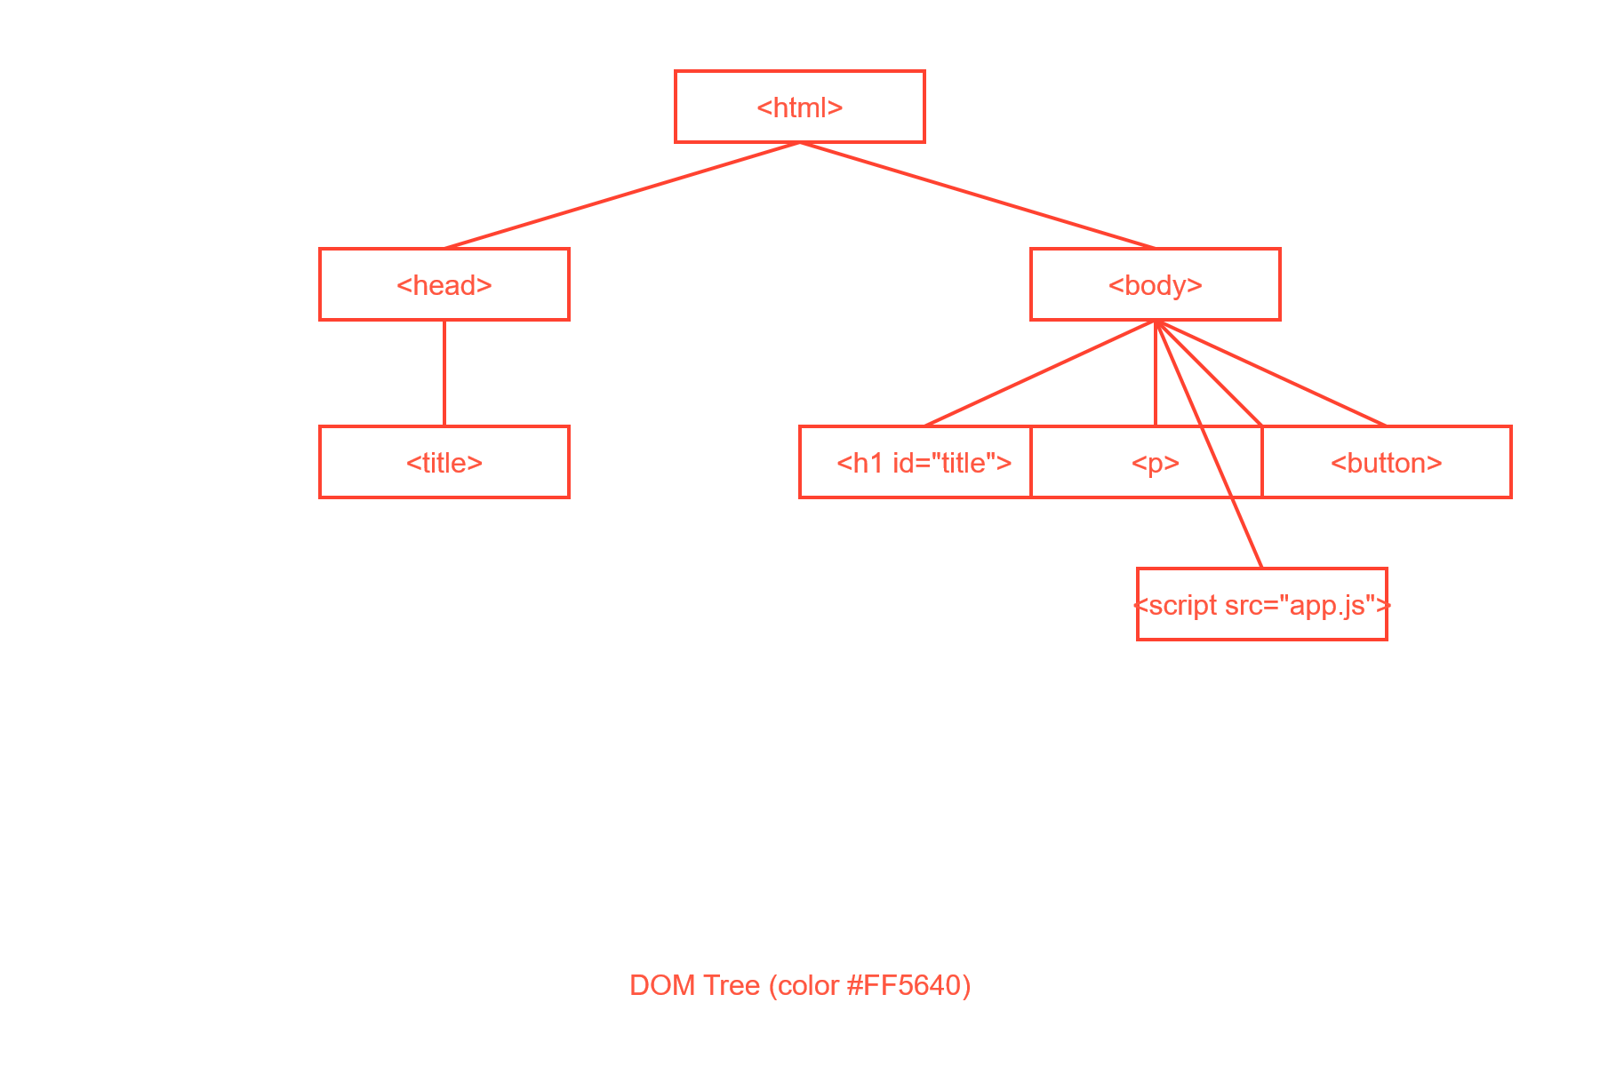
What is DOM ?
The DOM (Document Object Model) is a tree-like structure that the browser creates from your HTML.
It represents everything on the page — headings, paragraphs, buttons, images — as objects that JavaScript can access and manipulate.
🌳 DOM as a Tree
The DOM is structured like a tree:
Each HTML tag becomes a node in this tree — and JavaScript can traverse or modify any part of it.

Slide 5
DOM vs HTML — Key Difference
HTML | DOM
The original file | The live structure in memory
Doesn’t change after page load | DOM can be updated by JS anytime
Written by you | Created by the browser

Slide 6

What Happens When You Click "Go Live" in VS Code ?

Slide 7
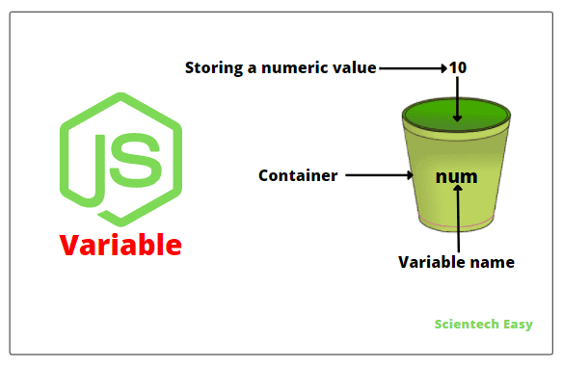
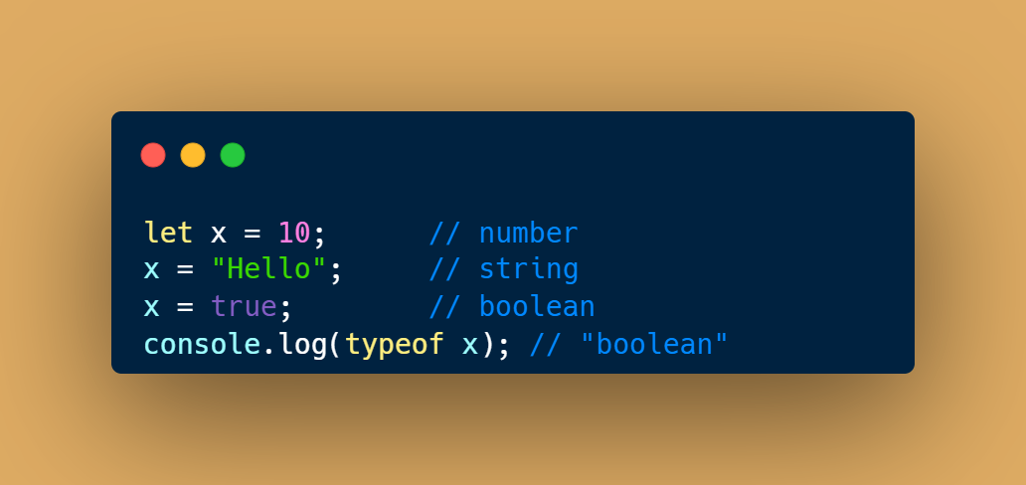
Variables
Variables are containers for storing data values
Box analogy: 📦 “A box with a label that stores data.”
JavaScript is dynamically typed:
You don’t declare the type — JS figures it out at runtime.
A variable’s type can change as the program runs.

Slide 8
Variable Rules
Variable names are case sensitive ; “a” and “A” are different .
Only letters, digits, underscore(_) and $ is allowed ( not even space).
Only letter, underscore(_) or $ should be 1st character.
Reserved words cannot be variable names.
Reserved words: https://www.w3schools.com/js/js_reserved.asp

Slide 9
let,const & var
let
const
var
Block-scoped → only lives inside { }
Cannot be re-declared in the same scope
Best for variables that change
Same scoping rules as let (block-scoped)
Must be initialized at declaration
Cannot be reassigned
BUT: If it’s an object/array, you can mutate its contents
Function-scoped (ignores block { })
Allows re-declaration in the same scope
Problematic in loops & blocks
Notes:
Presentation Principles
This slide provides a handful of key ideas to help you make great presentations.
It can also be used as a template slide. Change the header (and footer) to reflect the client, presentation name, and chapter title. To change the header and footer, click “edit master” and change the header and footer on all the master slides to have the same client and presentation name across all pages.

Slide 10
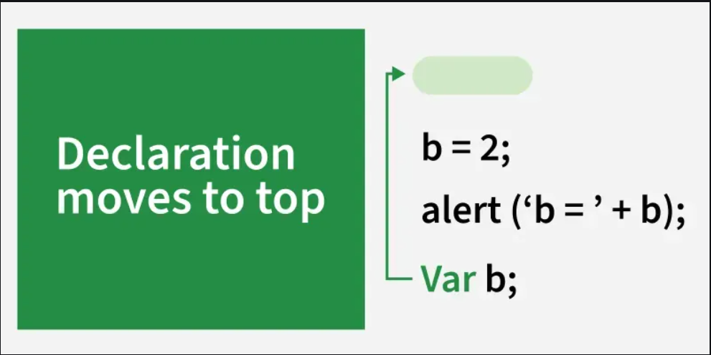
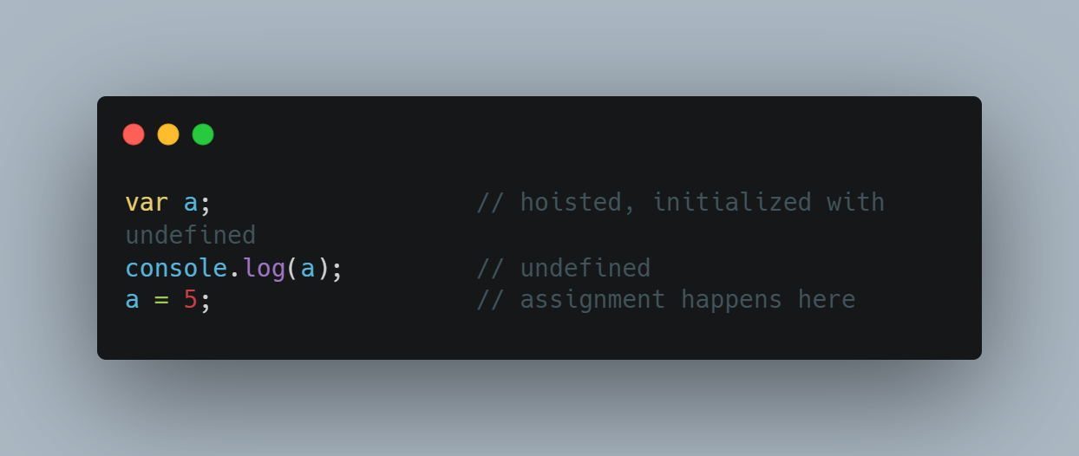
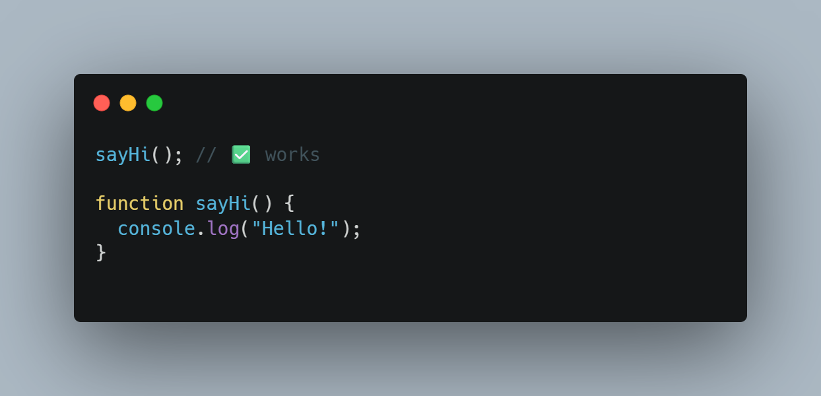
What is Hoisting ?
In JavaScript, declarations (variables & functions) are moved to the top of their scope by the JS engine before code is executed.
This means variables/functions can be known to exist even before their actual line of code is run.
Function declarations are fully hoisted

Slide 11
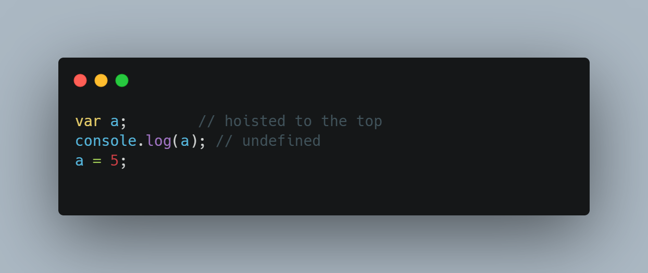
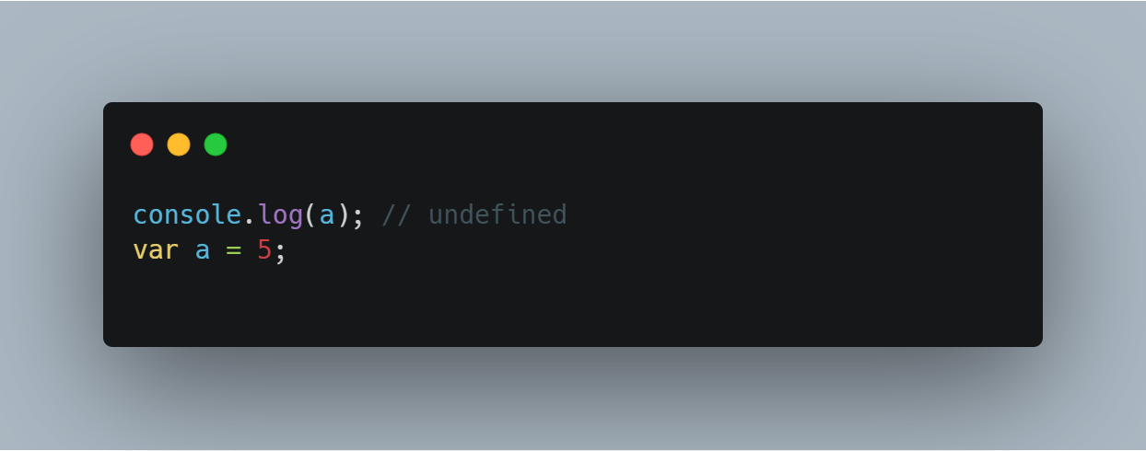
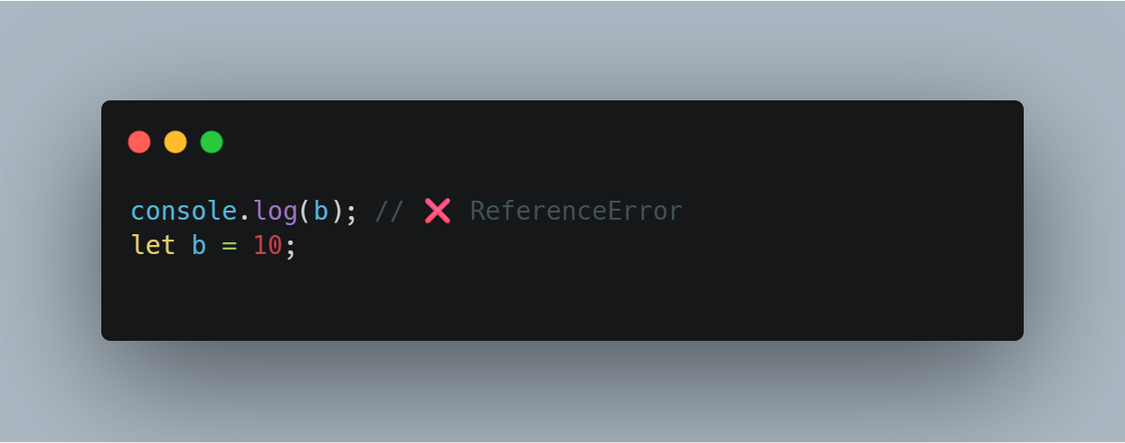
🧪 Example with var
❗ Because this is how JavaScript interprets it internally:
🧠 So: The declaration is hoisted, but the value assignment is not.
Temporal Dead Zone (TDZ)
The Temporal Dead Zone is the period between hoisting a variable declared with let or const, and its actual initialization, during which the variable cannot be accessed.
b is hoisted, but it’s in the TDZ.
You can't access it until the line let b = 10; is executed.

Slide 12
Operators
JavaScript operators are symbols or keywords used to perform operations on values or variables.
They are essential in making logical decisions, performing arithmetic, and manipulating data.
Arithmetic Operators
Used for math:
+ → Addition
- → Subtraction
* → Multiplication
/ → Division
% → Modulus (remainder)
** → Exponentiation (power)
++ → Increment
-- → Decrement
Assignment Operators
Used to assign values:
= → assign
+= → add & assign
-= → subtract & assign
*= → multiply & assign
/= → divide & assign
Comparison Operators
Used to compare values (returns true or false):
== → equal (checks only value)
=== → strict equal (checks value + type)
!= → not equal
!== → strict not equal
> , < , >= , <=
Logical Operators
Used for combining conditions:
&& → AND
|| → OR
! → NOT

Slide 13

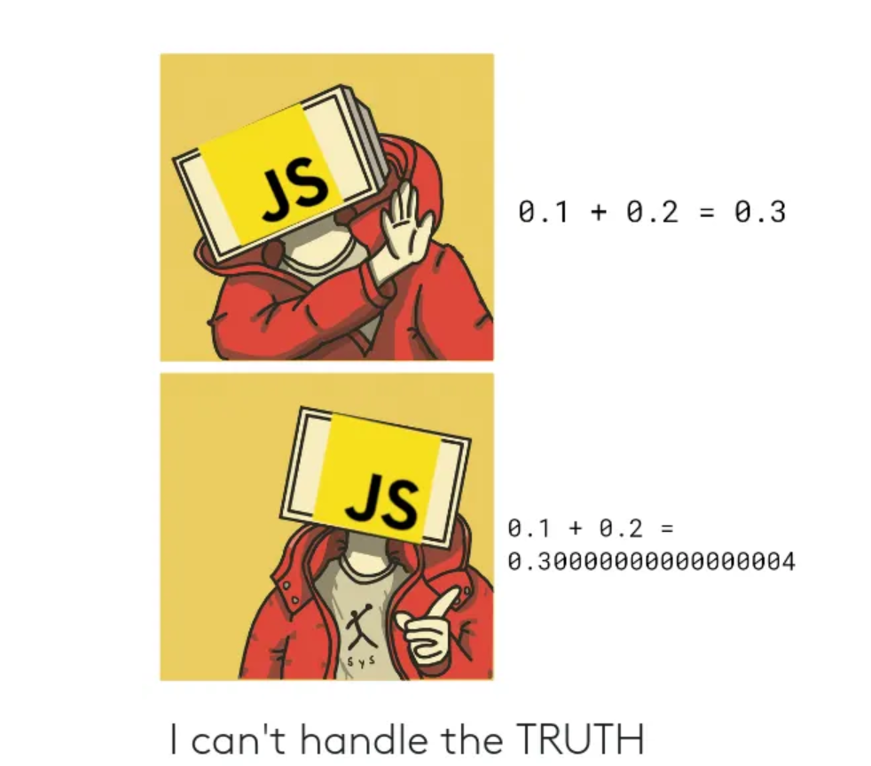
console.log(0.1+0.2!==0.3) ?
True / False
https://gauravkk22.medium.com/why-0-1-0-2-0-3-is-false-in-js-mystery-unsolved-with-solution-4f7db2755f18
Notes:
Presentation Matters
This slide provides justification for caring about how your presentations look and feel.
It can also be used as a template slide. Change the header (and footer) to reflect the client, presentation name, and chapter title. To change the header and footer, click “edit master” and change the header and footer on all the master slides to have the same client and presentation name across all pages.

Slide 14

Exercise
*
Exercise 1
💡 Swap Two Variables Without Using a Third Variable
Problem: You have two variables a and b. Swap their values using only arithmetic operators (no extra variables or data structures).
🔹 Use only: variables + arithmetic operators 🔹 Test with different values of a and b
Exercise 2
Find the Type of a Variable and Manipulate Accordingly
Problem: Create a variable value and assign it a random value (e.g., number, string, boolean). Now use typeof and logical/comparison operators to:
If it's a number, multiply it by 10
If it's a string, append " JS" to it
If it's a boolean, invert it (true becomes false, and vice versa)
🔹 Only use: variable declaration (let, const), assignment, and operators 🔹 No conditionals or loops

Slide 15
Conditional Statements
Conditional statements allow a program to make decisions and run different code based on conditions.
Statements | Description
if | executes a block of code if a specified condition is true.
if...else | executes one block of code if the condition is true, and another block of code if the condition is false.
if...elseif...else | It executes the first block of code for which the condition is true. If none of the conditions are true, it executes the else block.
Switch | Perform different actions based on different conditions. It's often used when you have many conditions to check and want to avoid multiple if checks.
Ternary | if-else (shortcut)

Slide 16
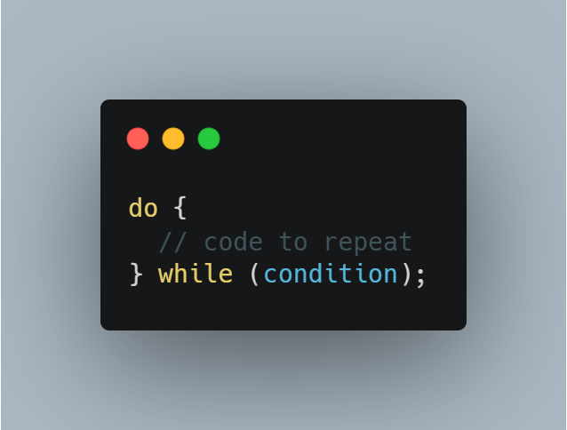
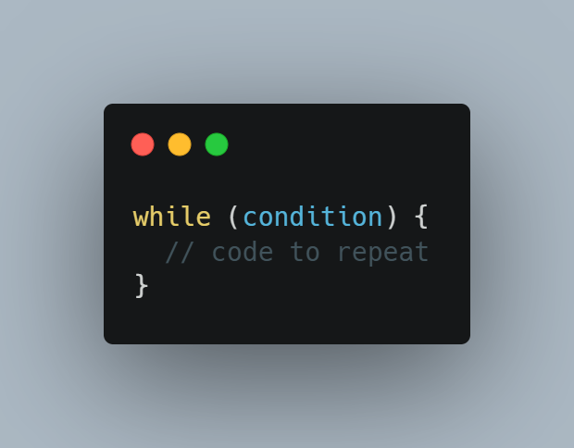
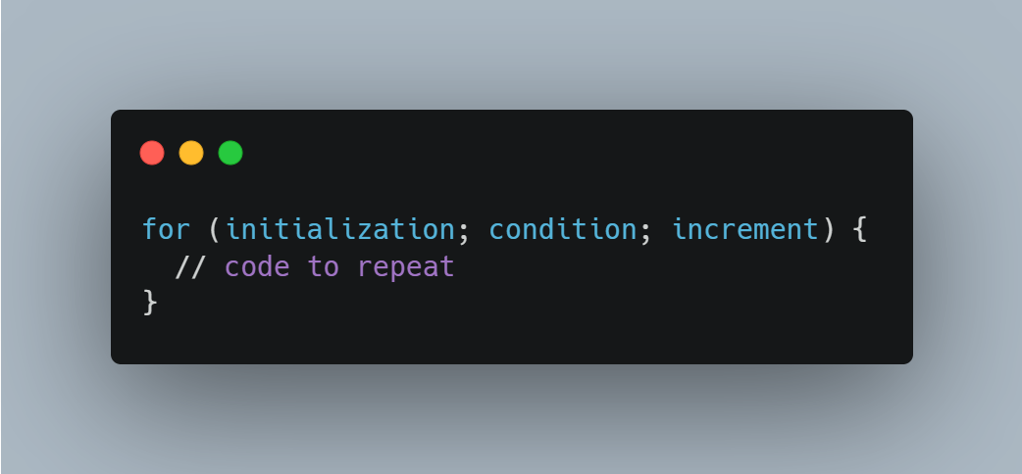
Loops
Loops let you repeat a block of code multiple times without writing it again 🌀 .
A for loop repeats a block of code a specific number of times by using three parts—initialization, condition, and update—that control the start, stop, and step of the loop.
A while loop repeats a block of code as long as its condition is true. It checks the condition before each run, so it may run zero or more times.
A do…while loop runs its block at least once, then repeats while the condition is true. The condition is checked after the body.
For
While
Do While

Slide 17
Loop Control Statements
Continue
Break
The continue statement is used to skip the current iteration of a loop and move to the next iteration
The break statement is used to exit a loop immediately, regardless of the loop's condition.
When the continue statement is encountered, the code following it in the loop is not executed for the current iteration
Once a break statement is encountered, the loop is terminated, and the control is passed to the next statement following the loop

Slide 18
Exercise
*
Exercise 1
Print All Prime Numbers from 1 to 100
Problem Statement: Use loops and conditionals to print all prime numbers between 1 and 100.
Exercise 2
Check if a Number is a Palindrome (Without Strings)
Problem Statement:
Write a program to check whether a given number (like 121, 1221, 12321) is a palindrome — i.e., it reads the same backward and forward.
🔹 You must not convert the number to a string.

Slide 19
Built In Types
Built-in types (also called primitive types and objects) are the data types that JavaScript already provides
Primitive
Objects
Stored directly in memory
Each variable holds its own copy of the value
Changing one variable does not affect another
Stored in heap memory
The variable holds a reference (pointer) to the actual object in memory
If you assign one object to another, they both point to the same object
| Types: object, array, function,maps,sets |
| Types: string, number, boolean, undefined, null, bigint, symbol |
https://www.w3schools.com/js/js_datatypes.asp

Slide 20
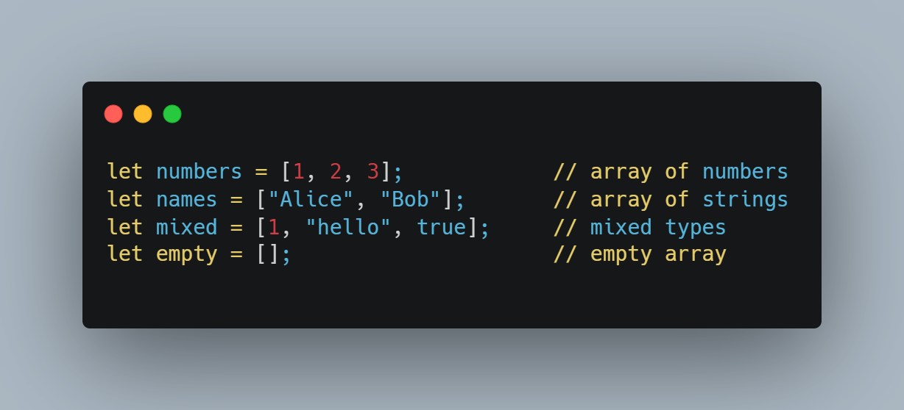
Arrays
An Array in JavaScript is a special variable that can hold multiple values in a single variable.
Method | What It Does | Example
push() | Add item at end | arr.push(4)
pop() | Remove item from end | arr.pop()
shift() | Remove first item | arr.shift()
unshift() | Add item at start | arr.unshift(0)
splice() | Add/remove items at specific index | arr.splice(1, 1, "new")
slice() | Returns a portion of the array | arr.slice(0, 2)
concat() | Combines two arrays | arr1.concat(arr2)
indexOf() | Finds index of value | arr.indexOf("apple")
includes() | Checks if value exists | arr.includes("apple")
join() | Turns array into a string | arr.join(", ")
reverse() | Reverses the array | arr.reverse()
sort() | Sorts the array | arr.sort()
map() | Transforms each item | arr.map(x => x * 2)
filter() | Filters based on condition | arr.filter(x => x > 2)
reduce() | Reduces to single value (e.g., sum) | arr.reduce((a, b) => a + b)
Creating Arrays
Common Array Methods

Slide 21
Exercise
*
Exercise 1
Write a function that takes a string and returns an object where the keys are the characters, and the values are the number of times they appear in the string..
Exercise 2
Write a function that takes a sentence (string) as input and returns an array of objects. Each object should contain the word and its length.

Slide 22
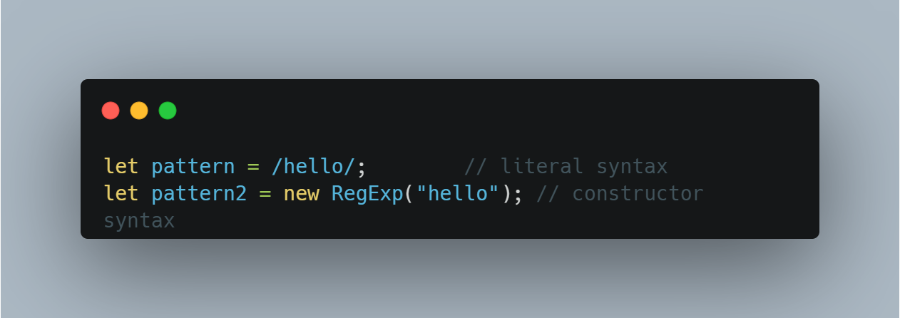
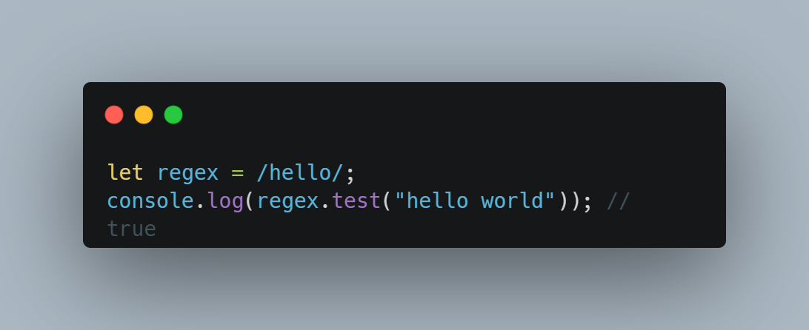
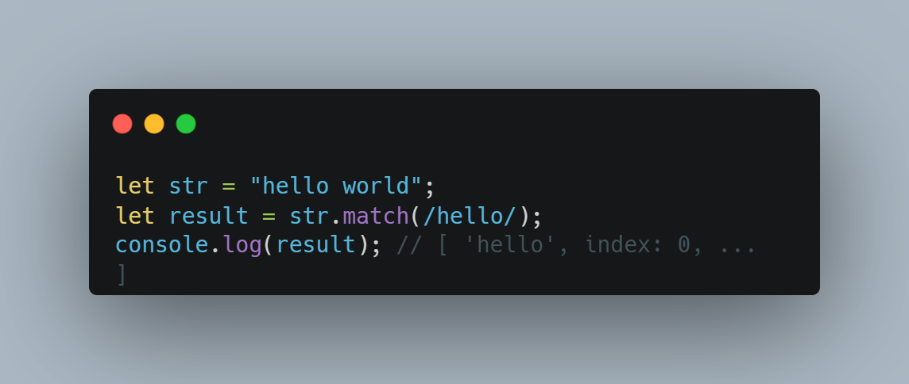
Regular Expressions (regex)
Regex (Regular Expression) is a pattern-matching tool used to search, match, or replace text in strings.
Two ways to create a regex:
Common Regex Usage in JavaScript:
test() – checks if a string matches the pattern
match() – returns matches as an array

Slide 23
Common Regex Patterns:
Pattern | Meaning | Example Match
. | Any character (except newline) | a, 1, @
\d | Any digit (0–9) | 5, 8
\w | Word character (A-Z, a-z, 0-9, _) | hello_123
\s | Whitespace | space, tab, newline
^ | Start of string | ^hello matches "hello world"
$ | End of string | world$
[...] | Any character in brackets | [aeiou]
` | ` | OR
+ | One or more | \d+ → "123"
* | Zero or more | \d* → "" or "123"
? | Optional | colou?r → "color" or "colour"
{n} | Exactly n times | \d{3} → "123"

Slide 24
Exercise
*
Exercise 1
You are building a mini system to validate user emails from a signup form. You are given an array of email strings. Your task is to:
Validate each email using a regular expression
Categorize emails as valid or invalid
Return an object with:
An array of valid emails
An array of invalid emails
Count of each
Percentage of valid emails (rounded down)

Slide 25
Exercise
*
Exercise 2
You are building a user registration validator. You’re given an array of user objects, where each object contains a username and a password.
Your job is to:
Clean up the username (remove leading/trailing spaces and convert to lowercase)
Check if the username only contains alphanumeric characters using regex
Check if the password is strong, based on the following rules:
At least 8 characters
Must include at least 1 number
Must include at least 1 uppercase letter
Must include at least 1 special character (!@#$%^&*)
Return a summary report of:
Sanitized usernames
Strong passwords list
Count of weak passwords
Total processed users

Slide 26

Thank you!
Chandu B R
Junior Developer
chandu.busanahalliravindra@endava.com
Feel free to reach out with any questions or thoughts!

